Slide 1
Phase Diagrams &
Phase Tranformation

Slide 2
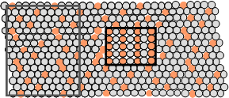
Phase Diagram
If we specify...
--a composition (e.g., wt% Cu - wt% Ni), and
--a temperature (T )
then...
How many phases do we get? What are those?
What is the composition of each phase?
How much of each phase do we get?
Phase A
Phase B
Nickel atom
Copper atom

Slide 3
Phase Diagram
Three externally controllable parameters that affect phase fraction and composition
    Temperature
    Pressure
    Composition
Phase diagram is constructed when various combinations of these parameters are plotted against one another
Shows the phase stability regions

Slide 4
Basic Definitions
Alloy: A metallic substance that is composed of two or more elements.
Component: A chemical constituent (element or compound) of an alloy, which may be used to specify its composition.
Phase: A homogeneous portion of a system that has uniform physical and chemical characteristics.
Equilibrium: The state of a system where the phase characteristics remain constant over indefinite time periods.
  At equilibrium the free energy is a minimum.

Slide 5
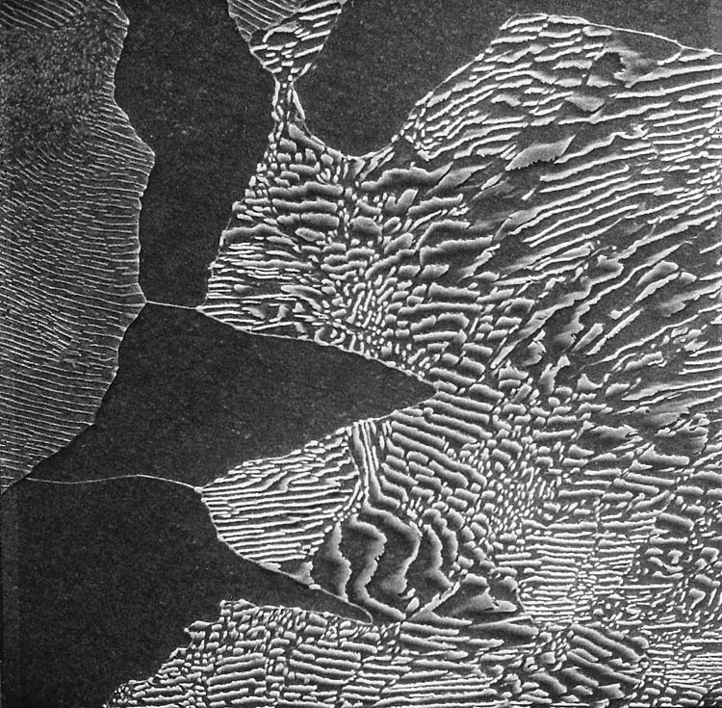
Microstructure - Phases
Ferrite
Cementite
SEM micrograph
3000 x magnification
Plain C steel containing 0.44 wt. % C
Notes:
p_pg252.jpg

Slide 6
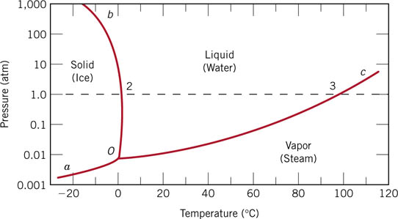
Unary (One component) phase diagram
Notes:
f02_09_pg257.jpg

Slide 7
Phase Equilibria: Solubility Limit
  Solutions – solid solutions, single phase
  Mixtures – more than one phase
Sucrose/Water Phase Diagram
• Solubility Limit:
Max concentration for
which only a single phase
solution occurs.
10
0
Solubility
8
0
Limit
L
(liquid)
6
0
L
+
Temperature (°C)
Question: What is the
solubility limit at 20°C?
(liquid solution
S
4
0
i.e., syrup)
(solid
20
sugar)
Answer: 65 wt% sugar.
If C_{o} < 65 wt% sugar: syrup
If C_{o} > 65 wt% sugar: syrup + sugar.
0
20
40
60
65
80
100
C_{o}
=Composition (wt% sugar)
Water
Sugar
Pure
Pure

Slide 8
Effect of T & Composition (C_{o})
• Changing T can change # of phases:
path A to B.
Changing C_{o} can change # of phases:
path B to D.
B (100°C,70)
1 phase
D (100°C,90)
2 phases
100
80
L
(liquid)
water-
sugar
system
60
+
L
S
Temperature (°C)
(
liquid solution
40
(solid
i.e., syrup)
sugar)
20
A (20°C,70)
2 phases
0
0
20
40
60
70
80
100
C_{o}
=Composition (wt% sugar)

Slide 9
Phase Equilibria
Simple solution system (e.g., Ni-Cu solution)
 | Crystal Structure | electroneg | r (nm)
Ni | FCC | 1.9 | 0.1246
Cu | FCC | 1.8 | 0.1278
Both have the same crystal structure (FCC) and have
similar electronegativities and atomic radii (W. Hume –
Rothery rules) suggesting high mutual solubility.
Ni and Cu are totally miscible in all proportions.

Slide 10
Phase Diagrams
• Indicate phases as function of T, C_{o}, and P.
• For this course:
-binary systems: just 2 components.
-independent variables: T and C_{o} (P = 1 atm is almost always used).
T(°C)
• Phase
Diagram
for Cu-Ni
system
1600
• 2 phases:
L
(liquid)
1500
L (liquid)
α
(FCC solid solution)
1400
liquidus
α
1300
+
L
solidus
1200
α
(FCC solid
1100
solution)
1000
wt% Ni
0
20
40
60
80
100

Slide 11
Phase Diagrams:
# and types of phases
• Rule 1: If we know T and C_{o}, then we know:
--the # and types of phases present.
T(°C)
• Examples:
1600
A(1100°C, 60):
L (liquid)
1 phase:
α
1500
Cu-Ni
phase
diagram
liquidus
B
(1250°C, 35):
1400
(1250°C,35)
α
solidus
2 phases: L +
α
1300
+
α
B
L
(FCC solid
1200
solution)
1100
A(1100°C,60)
1000
wt% Ni
0
20
40
60
80
100

Slide 12
Phase Diagrams: composition of phases
• Rule 2: If we know T and C_{o}, then we know:
--the composition of each phase.
Cu-Ni system
• Examples:
T(°C)
C
= 35 wt% Ni
T
A
o
A
tie line
L (liquid)
liquidus
At T
A
= 1320°C:
1300
α
L
+
Only Liquid (L)
B
C
L
= C
o
( = 35 wt% Ni)
T
B
solidus
α
α
At T
D
= 1190°C:
L
+
1200
D
(solid)
Only Solid (
α
)
T
D
C
α
= C
o
( = 35 wt% Ni
)
20
30
32
35
40
4
3
50
At T
B
= 1250°C:
C
L
C
o
C
α
wt% Ni
Both
α
and L
C
L
= C
liquidus
( = 32 wt% Ni here)
C
α
= C
solidus
( = 43 wt% Ni here)

Slide 13
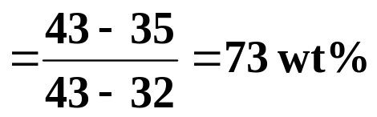
Phase Diagrams: weight fractions of phases
• Rule 3: If we know T and C_{o}, then we know:
--the amount of each phase (given in wt%).
Cu-Ni system
• Examples:
T(°C)
C
o
= 35 wt% Ni
T
A
A
tie line
At T
A
: Only Liquid (L)
L (liquid)
liquidus
1300
α
W
= 100 wt%, W
α
= 0
L
+
L
B
At T
D
:
Only Solid (
α
)
T
B
R
S
solidus
W
= 0, W
= 100 wt%
α
α
L
α
L
+
1200
D
(solid)
At T
B
:
Both
α
and L
T
D
=
S
20
3
0
32
35
4
0
4
3
5
0
W_{L}
R
+
S
C
L
C
o
C
α
wt% Ni
=
R
W_{α}
= 27 wt%
R
+
S

Slide 14
Gibbs Phase Rule
F=C-P+2
Degrees of Freedom
Number of components
Number of phases
How many number of intensive variables we have to specify to completely define/ specify the system
How many number of intensive variables that can be independently changed without changing the number of phases

Slide 15
Gibbs Phase Rule
Intensive variables of the system:
  Temperature of each phase
  Pressure of each phase
  Composition of each phase = Relative concentration of each component in that phase
Temperature of each phase is equal and is equal to the temperature of the system
Pressure of each phase is equal and is equal to the pressure of the system
To completely define the system means: specifying temperature, pressure and relative concentrations of each component in each phase of the system

Slide 16
Gibbs Phase Rule
If any of the intensive variable is fixed at a constant value, then the applied Gibbs phase rule would be
F=C-P+1
Usually all metallic system phase diagrams are drawn for fixed constant pressure of 1 atm. Pressure
So the above Gibbs phase rule will be applied

Slide 17
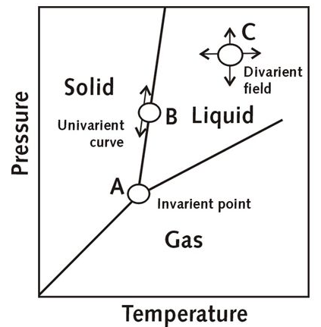
Gibbs Phase Rule

Slide 18
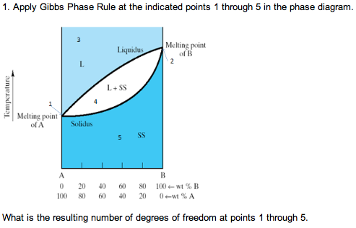
Gibbs Phase Rule

